Slide 1
Demo of App
Sean House
Click to Start

Slide 2




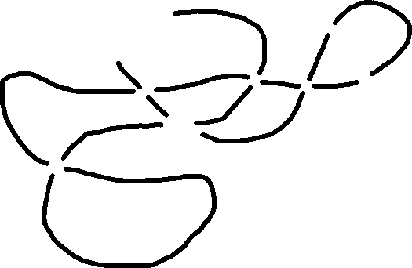
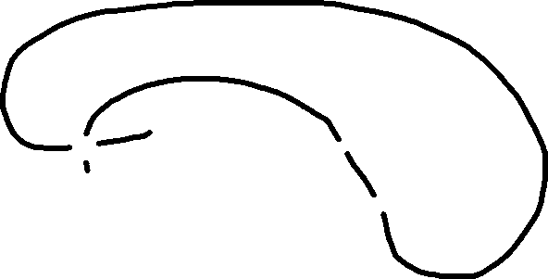
Untitled Knot
Systematics
or
Save
Log In
Sign Up
Notes:
Start

Slide 3
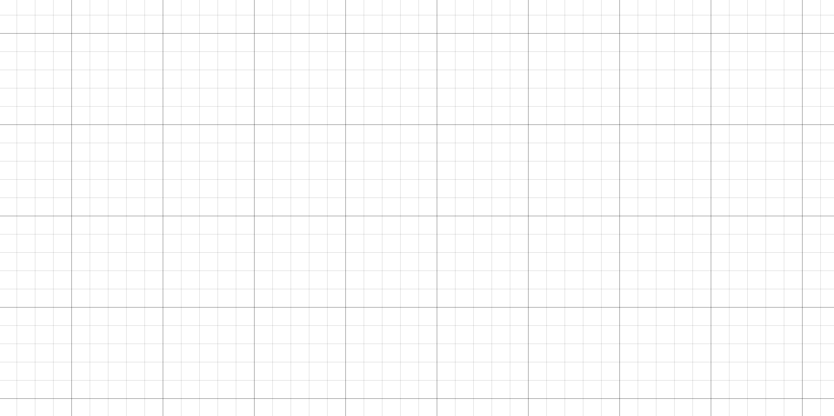
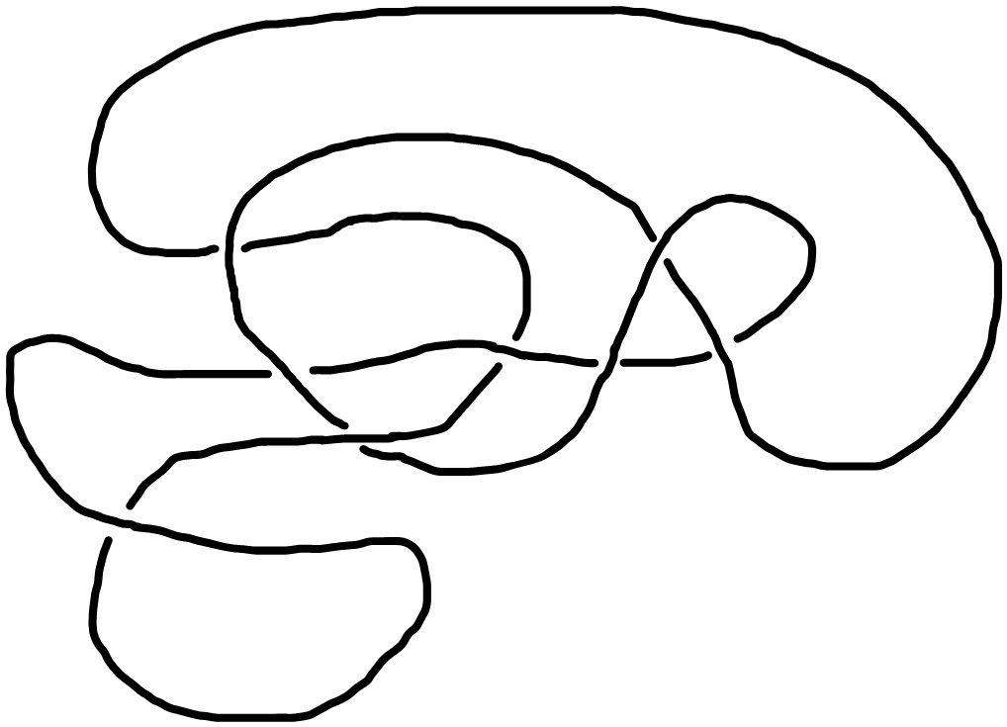

Untitled Knot
Systematics
or
Save
Log In
Sign Up
Notes:
Zoom in

Slide 4
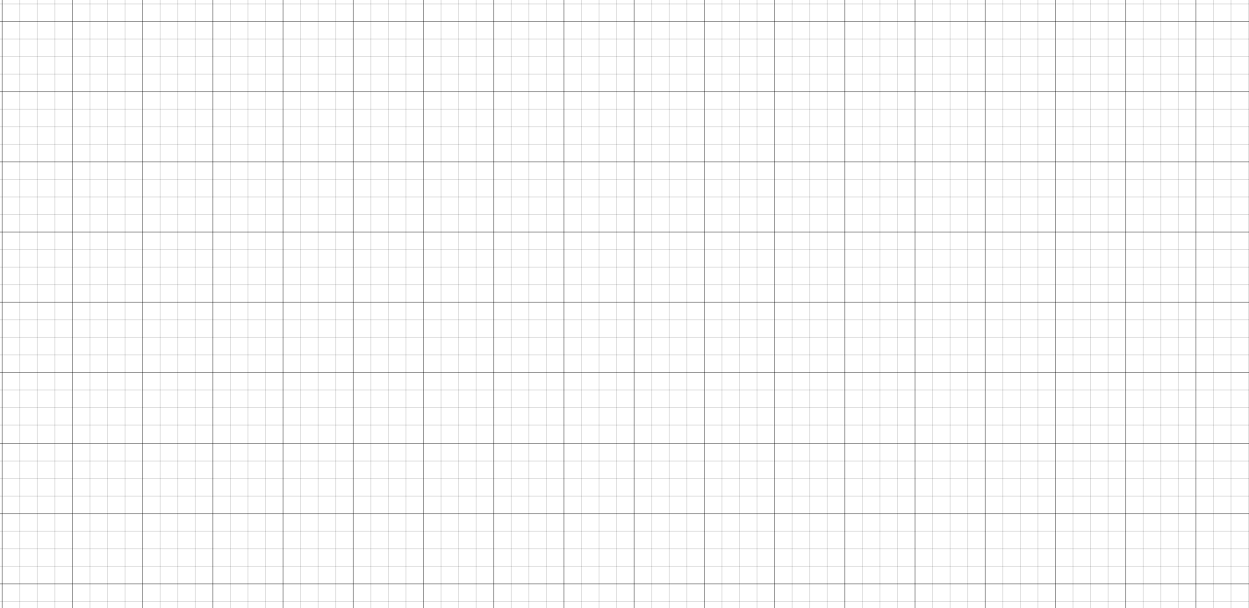
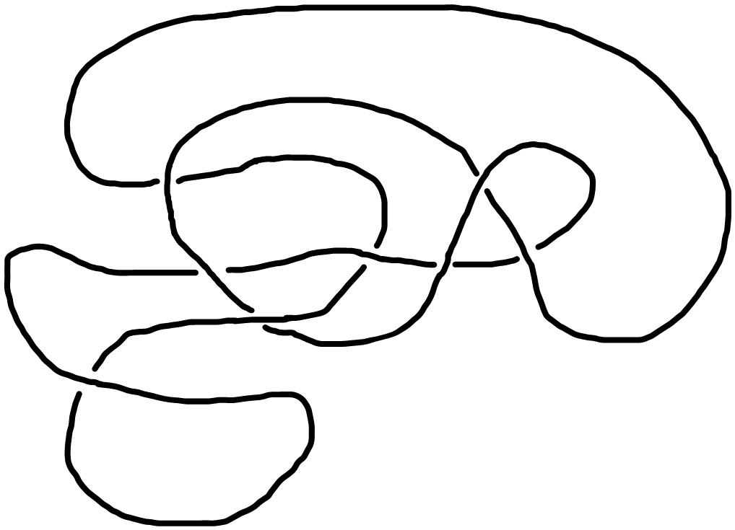
Untitled Knot
Systematics
or
Save
Log In
Sign Up
Notes:
Zoom out

Slide 5
Untitled Knot
Systematics
or
Save
Log In
Sign Up
Log In
New here? Sign Up.
Email
Password
Forgot password?
Log In
Notes:
Login

Slide 6
Untitled Knot
Systematics
or
Save
Log In
Sign Up
Recover Password
Password recovery email sent. Please check your inbox.
Notes:
Forgot password

Slide 7
Untitled Knot
Systematics
or
Save
Log In
Sign Up
Error
An error occurred. Please try again later.
Notes:
Login/Sign-up fail

Slide 8
Untitled Knot
Systematics
or
Save
Log In
Sign Up
Sign-Up
Already have an account? Log In.
Email
Password
Create Account
Notes:
Sign Up

Slide 9
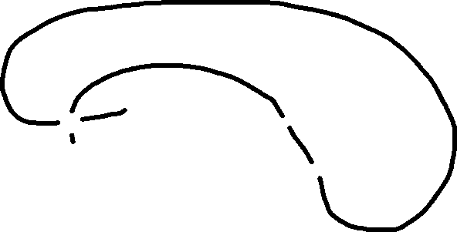
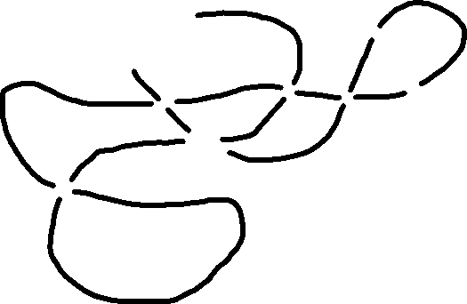
Untitled Knot
Systematics
or
Save
Log In
Sign Up
Link to knot copied to clipboard!
Notes:
Share

Slide 10

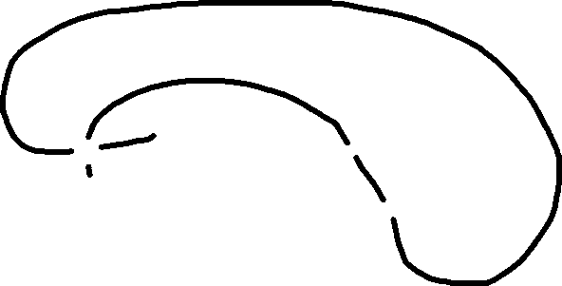
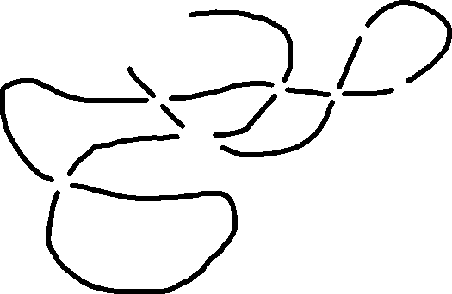
Untitled Knot
Systematics
or
Save
Log In
Sign Up
Log In
or
Sign Up
to save your drawings!
New Blank Drawing
Notes:
Menu?

Slide 11



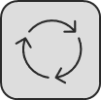


Untitled Knot
Systematics
or
Save
Log In
Sign Up
Toolbox
Notes:
Toolbox

Slide 12
Untitled Knot
Systematics
or
Save
Log In
Sign Up
Setting 1
Setting 2
Setting 3
Setting 4
.
.
.
Notes:
Settings

Slide 13


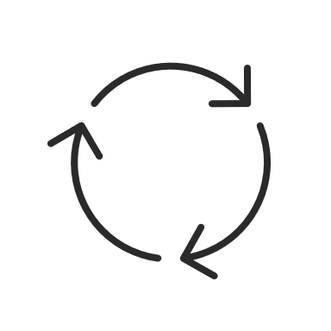

Alright, let’s get outta here
Shhh…. secret
Notes:
Secret slide where I made the toolbox buttons

